Slide 1
Basic Structure of C-Program

Slide 2
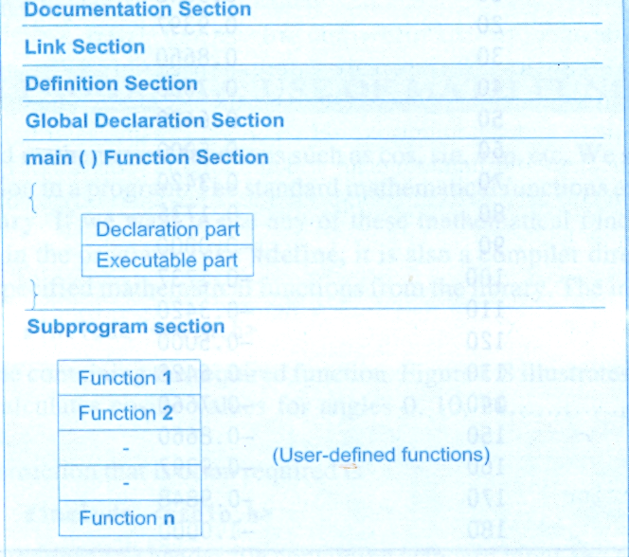
Structure of c-programs

Slide 3
Documentation Section
The Documentation Section consists of set of comment lines giving the
Name of the program
The author
Other Details which the programmer would like to use later
Syntax
/* Multiple Comment lines *\
// Single Comment line
Example
/* c –program to find gcd and lcm of two numbers using Euclid's Algorithm *\
// Welcome to C

Slide 4
Link Section
The link section provides instruction to the complier to link functions from system library
Syntax
#include<header file name .h>
Header files
stdio– Standard Input /Output
conio– Console input/Output,
math- contains mathematical functions like (cos(), sin(), sqrt(), abs())
Example
#include<stdio.h>
#include<conio.h>

Slide 5
Definition Section
This section is used to define symbolic constants
Syntax:-
#define symbolic-name constant-value
Example:-
#define pi 3.142
#define maxmarks 100
#define minmarks 35

Slide 6
Global declaration Section
In C There are two types of declarations
1.Local variable declaration
2. Global variable Declaration
Global variables are declared out side the main function
Local variables are declared inside the main function

Slide 7
Variable declaration
Syntax:-
data-type variable-name;
Ex:-
int a,x;
float b,c;
char name;

Slide 8
Main() function
C-program should have at least one main() function
Form:-
main()
{
local variables declaration
computation part
logic part
}

Slide 9
Reading data from input device (keyboard)
scanf() function is used to read the data from standard input device
Syntax:-
scanf(“format specifier”,&var1,&var2-----,&varn)
Example:-
scanf(“%d”,&a) for int data-type
scanf(“%f”,&b) for float data-type

Slide 10
Print data or variable
printf() is used to print the variable or data
Syntax:-
printf(“ message -format specifier”,var1,var2-----,varn)
Example:-
printf(“Welcome to c”);
int a=10;
printf(“value of a=%d”,a);

